Slide 1
Computer Networks
CS 430

Slide 2
Application Layer

Slide 3
Objectives
Principles of network applications
Web and HTTP
FTP
SMTP, POP3, IMAP
DNS
P2P networking and applications
Socket programming

Slide 4
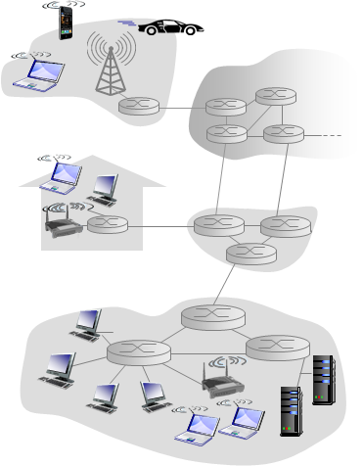
Creating a Network App
End systems
Communicate over network
Architecture
Client-server
Peer-to-peer
Message exchange
Socket API

Slide 5
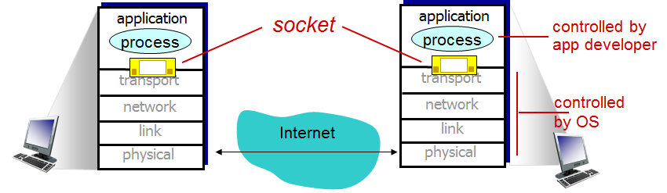
Sockets

Slide 6
Application Layer Protocol Tasks
Types of messages exchanged
e.g., request, response
Message syntax
what fields in messages & how fields are delineated
Message semantics
meaning of information in fields
Rules
when and how processes send & respond to messages

Slide 7
Application Layer Protocol Needs
Data integrity
Guaranteed delivery vs loss tolerance
TFTP, μTP
Timing
Delay and jitter
Throughput
Guaranteed vs elastic
Security
Encryption and integrity

Slide 8
Transport Service Requirements
Application | Data loss | Throughput | Time sensitive
File transfer | Not acceptable | Elastic | No
Email | Not acceptable | Elastic | No
Web page | Not acceptable | Elastic | No
Real-time AV | Tolerant | A: 5kbps-1Mbps V: 10kbps-5Mbps | 100s of msec
Stored AV | Tolerant | Same
Games | Tolerant | Same | Sec
Messaging | Not acceptable | Elastic | 100s of msec

Slide 9
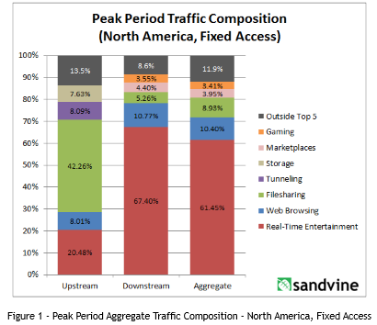
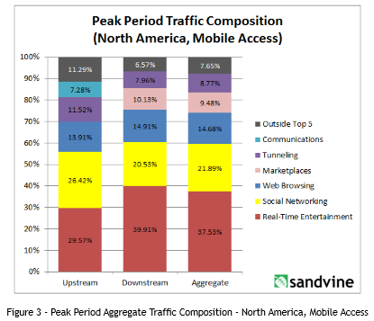
North America Traffic
Fixed Access
Mobile Access
Notes:
https://www.cisco.com/c/en/us/solutions/collateral/service-provider/visual-networking-index-vni/vni-hyperconnectivity-wp.html

Slide 10
The Web in September of 2001
Google
Facebook
YouTube
Yahoo!
Amazon
Wikipedia
eBay
LinkedIn
Twitter
Bing
Craigslist
Pinterest
1998 (September)
2004 (February)
2005 (February)
1994 (March)
1994
2001 (January)
1995 (September)
2003
2006 (March)
2009 (June)
1995
2010 (March)

Slide 11
Web History
Early days
Text-based
Dot-com bubble
Broadcast.com ($5.7B in 1999, closed later)
Geocities.com ($3.6B in 1999, closed in 2009)
Lycos ($12.5 billion in 2000, $100M in 2004)
Survivors
Amazon
eBay
Google
Post-2003
Web 2.0
Social networks
Entertainment

Slide 12
HTTP
Stateless
(Non-)persistent connections
How many TCP connections are necessary?
Request/response paradigm
GET, POST, HEAD, PUT, DELETE
Version
1.0 -> 1.1->2
Local storage
Cookies
HTML5

Slide 13
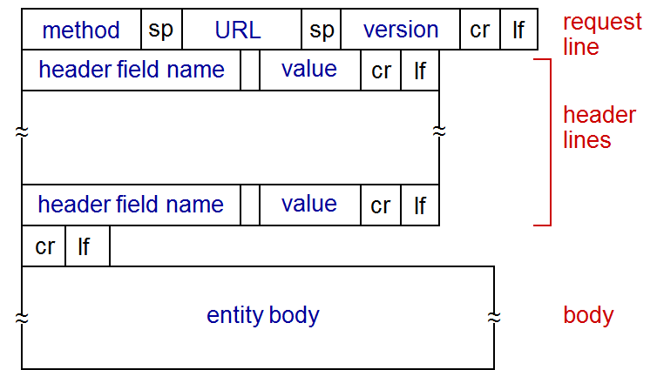
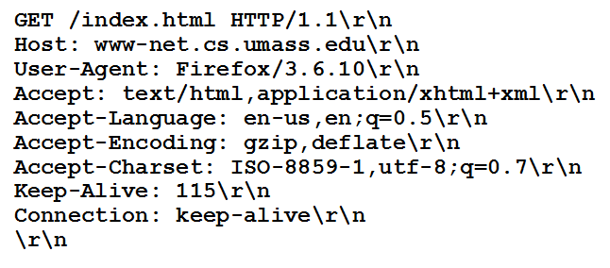
HTTP Request

Slide 14
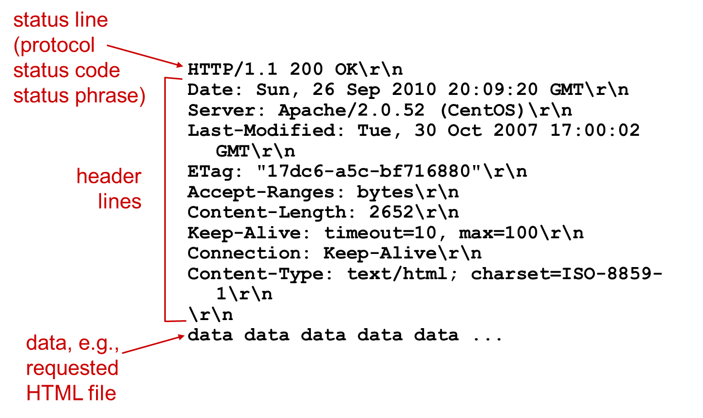
HTTP Response

Slide 15
HTTP Response Status Codes
2XX Success
200 OK
3XX Redirection
301 Moved Permanently
304 Not Modified
4XX Client Error
400 Bad Request
403 Forbidden
404 Not Found
5XX Server Error
502 Bad Gateway

Slide 16
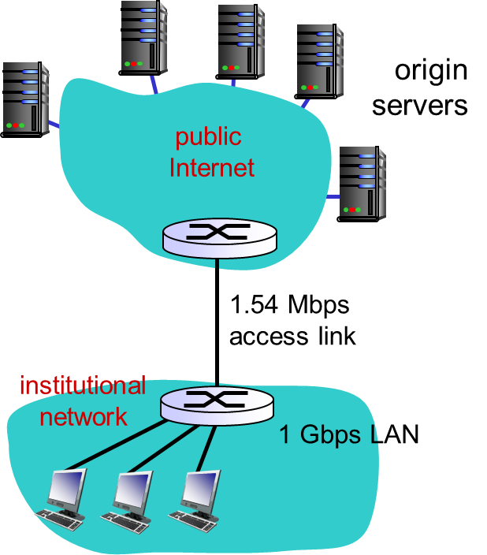
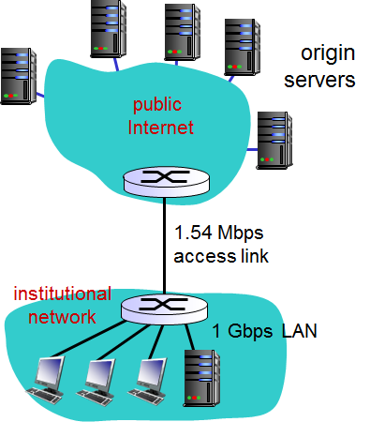
Web Cache

Slide 17
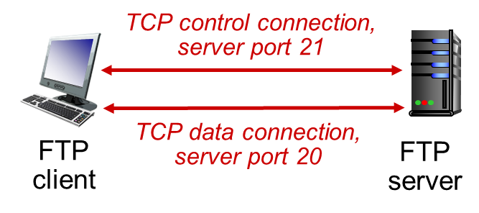
FTP Details
Two parallel connections
Control
Data
Security
None
SFTP
Stateful
Commands
USER username
PASS password
LIST directory
RETR retrieve (get)
STOR store (put)
Notes:
Try ftp://speedtest.tele2.net/

Slide 18
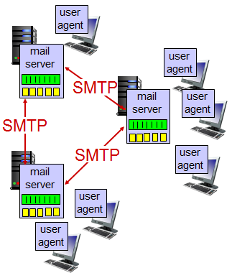
Email
SMTP
Push protocol
Commands
Ports 25, 465, 587
POP3
Pull protocol
Command/reply
Ports 110, 995
IMAP
Mailbox manipulation
Ports 143, 220, 993
Web mail

Slide 19
Directory and Naming Protocols
Domain Name System (DNS)
Distributed database
Hierarchy
Lightweight Directory Access Protocol (LDAP)
Phone book
Single sign-on
Windows Internet Name Service (WINS)
Used in older Windows networks

Slide 20
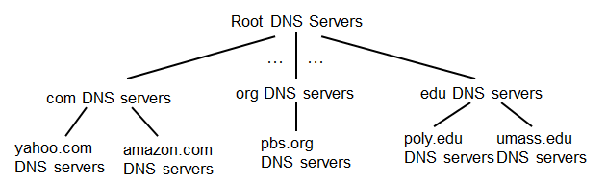
DNS
Client queries root server to find com DNS server
Client queries .com DNS server to get amazon.com DNS server
Client queries amazon.com DNS server to get IP address for www.amazon.com

Slide 21
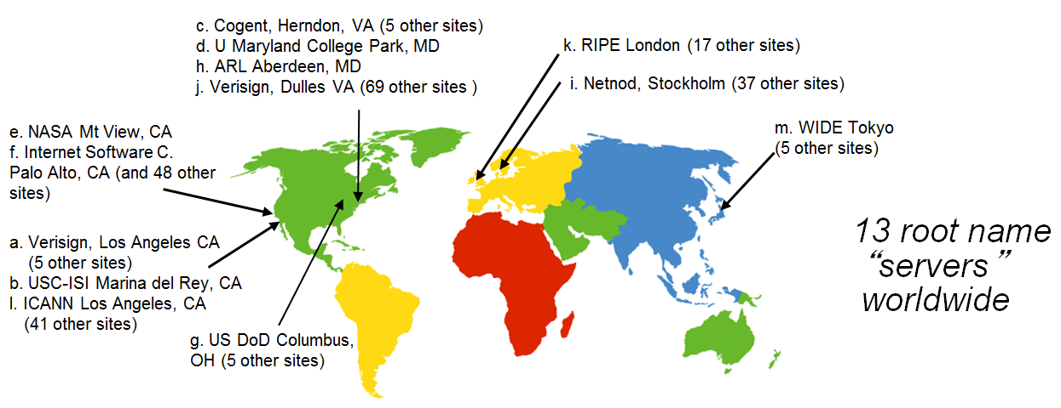
DNS Root Servers

Slide 22
Authoritative DNS Servers
Maintained by organization or service provider
Organization’s own DNS server
Provides authoritative hostname to IP mappings for organization’s named hosts

Slide 23
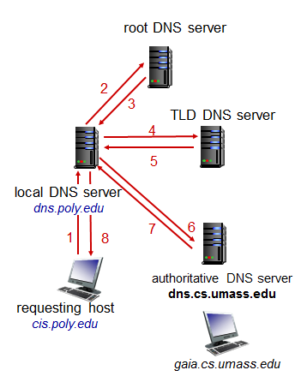
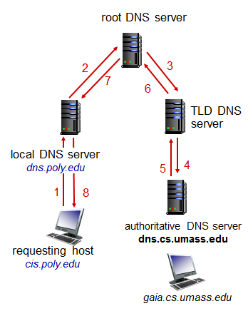
Name Resolution
Iterative Query
Recursive Query

Slide 24
DNS Caching
Any mapping learned is cached
Cache entries timeout after some time
TLD servers typically cached in local name servers
Root name servers not often visited
Cached entries may be out-of-date (best effort name-to-address translation!)
If name host changes IP address, may not be known Internet-wide until all TTLs expire

Slide 25
DNS Records
Record format: name, value, type, expiration
Type | Name | Value | Expiration
A | Hostname | IP address
NS | Domain | Authoritative name server for domain
CNAME | Alias name | Canonical name
MX | Mail server

Slide 26
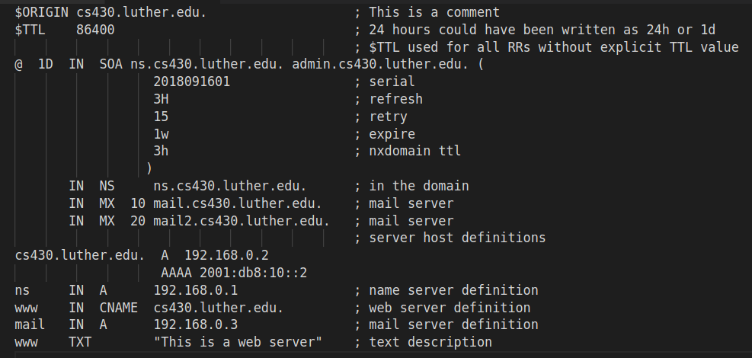
DNS Zone File

Slide 27
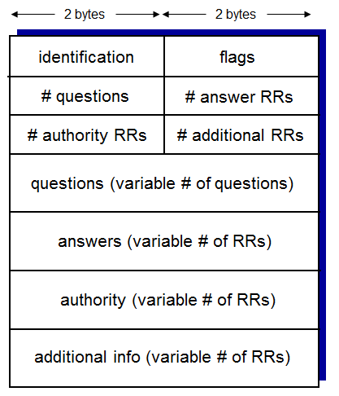
DNS Messages
Identification
Flags
Query/reply
Recursion desired/available
Authoritative reply
Question (request)
Answer (response)
Authoritative servers
Additional info

Slide 28
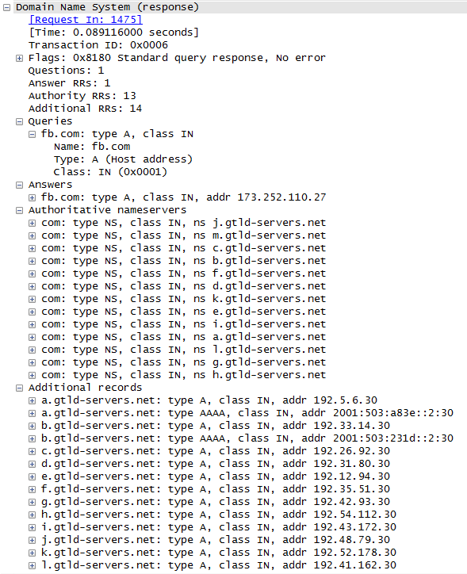
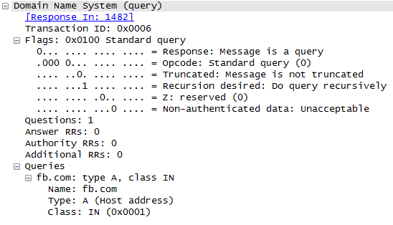
DNS Messages
Request
Response

Slide 29
Attacking DNS
DDoS attacks
Bombard root servers with traffic
Traffic Filtering
Local DNS servers cache IPs of TLD servers, allowing root server bypass
Not successful to date
Bombard TLD servers
Potentially more dangerous
Redirect attacks
Man-in-middle
Intercept queries
DNS poisoning
Send bogus replies to DNS server, which caches
Exploit DNS for DDoS
Send queries with spoofed source address: target IP
Requires amplification

Slide 30
Peer-to-peer Architecture
Alternative to client/server
Load balancing
Bandwidth is limited
Resource sharing
File distribution (BitTorrent)
VoIP (Skype)

Slide 31
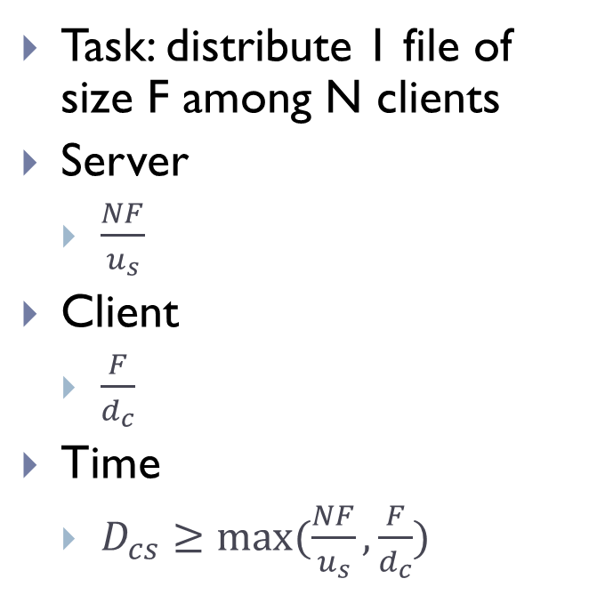
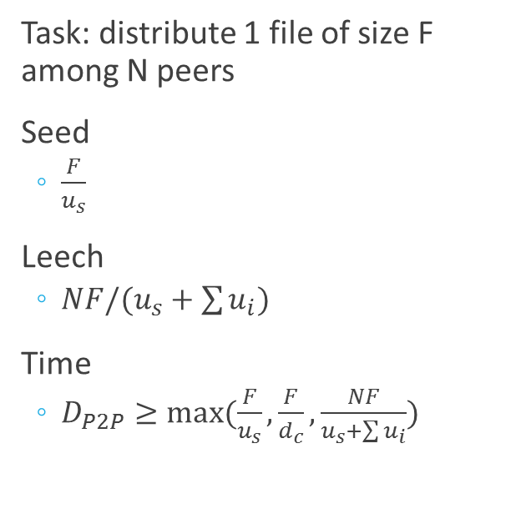
File Distribution
Client/Server
Peer-to-peer
Task: distribute 1 file of size F among N clients
Server
$\frac{NF}{u_{s}}$
Client
$\frac{F}{d_{c}}$
Time
$D_{cs}≥max⁡(\frac{NF}{u_{s}},\frac{F}{d_{c}})$
Task: distribute 1 file of size F among N peers
Seed
$\frac{F}{u_{s}}$
Leech
$NF/(u_{s}+\sum{u_{i})}$
Time
$D_{P2P}≥max⁡(\frac{F}{u_{s}},\frac{F}{d_{c}},\frac{NF}{u_{s}+\sum{u_{i}}})$

Slide 32
Client/server vs. P2P

Slide 33
BitTorrent
File(s) divided into 256Kb chunks
Peers in swarm receive identifiable chunks
May join and leave any time
Have different subsets of chunks
Rarest chunks downloaded first
Tracker tracks participating peers
Propagates list of peers
Tit-for-tat
A peer evaluates neighbors and sends to the top 4
+1 random
Choke (block) others

Slide 34
Distributed Hash Table
Distributed P2P database
Key : Value dictionary
Filename : IP address
A peer queries DHT with key
Receives matching values

Slide 35
File Sharing
Rising or declining?
Declining
31% in 2008
Major protocol/application?
Bittorrent
Country-specific

Slide 36
Bitcoin
Digital currency
Developed by Satoshi Nakamoto
Pseudonym
Bank/Google/NSA
“Mined” by users solving crypto puzzles
~50 bitcoins every 10 minutes
Distributed database of transactions
Block chain

Slide 37
Summary
Principles of network applications
Web and HTTP
FTP
SMTP, POP3, IMAP
DNS
P2P networking and applications
Socket programming

Slide 38
Thank You!

Slide 39
References
Alexa - Top Sites in United States
Global Internet Phenomena Report
The Rise and Fall of Bitcoin | Wired Magazine | Wired.com

